Slide 1
Unicorn: analysis by Erez Uriely, October 2022 DA-cohort
Analysis of data available on Unicorn's activities for the period November 2015 - December 2018.
The following are my main points.

Slide 2
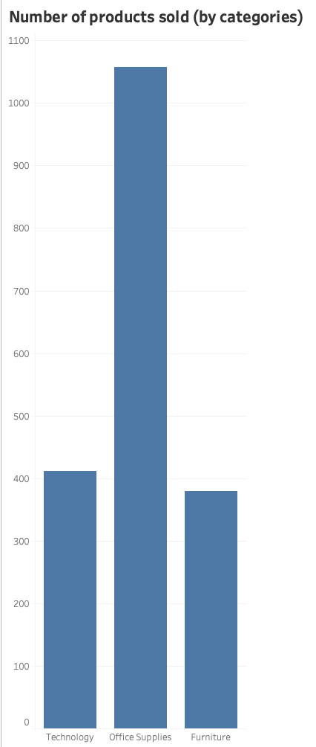
During 2015-2018, Unicorn sold 1,850 different products, divided into almost equal shares in the categories of technology, office supplies, and furniture.
Unicorn sells and ships products to 49 of the USA's 50 states.
During 2015-18, Unicorn delivered almost 10,000 orders to 793 unique customers.

Slide 3
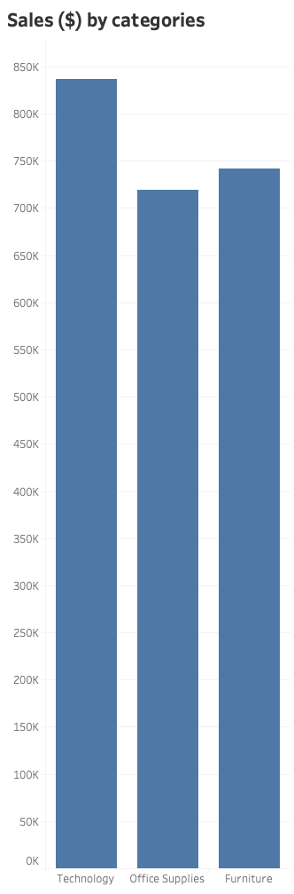
The sales (in USD) of Unicorn are almost equal in the categories of technology, office supplies and furniture.

Slide 4
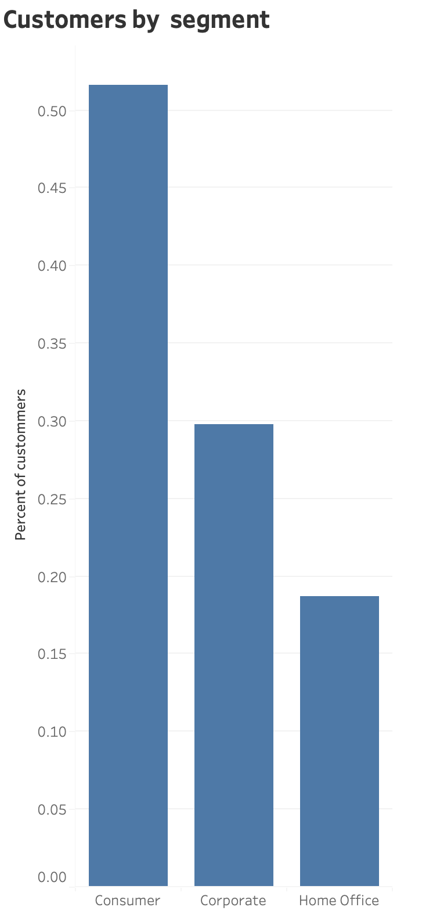
Ca 50% of the customers belongs to the consumer segment, 30% to corporate and 20% to home Office users.

Slide 5
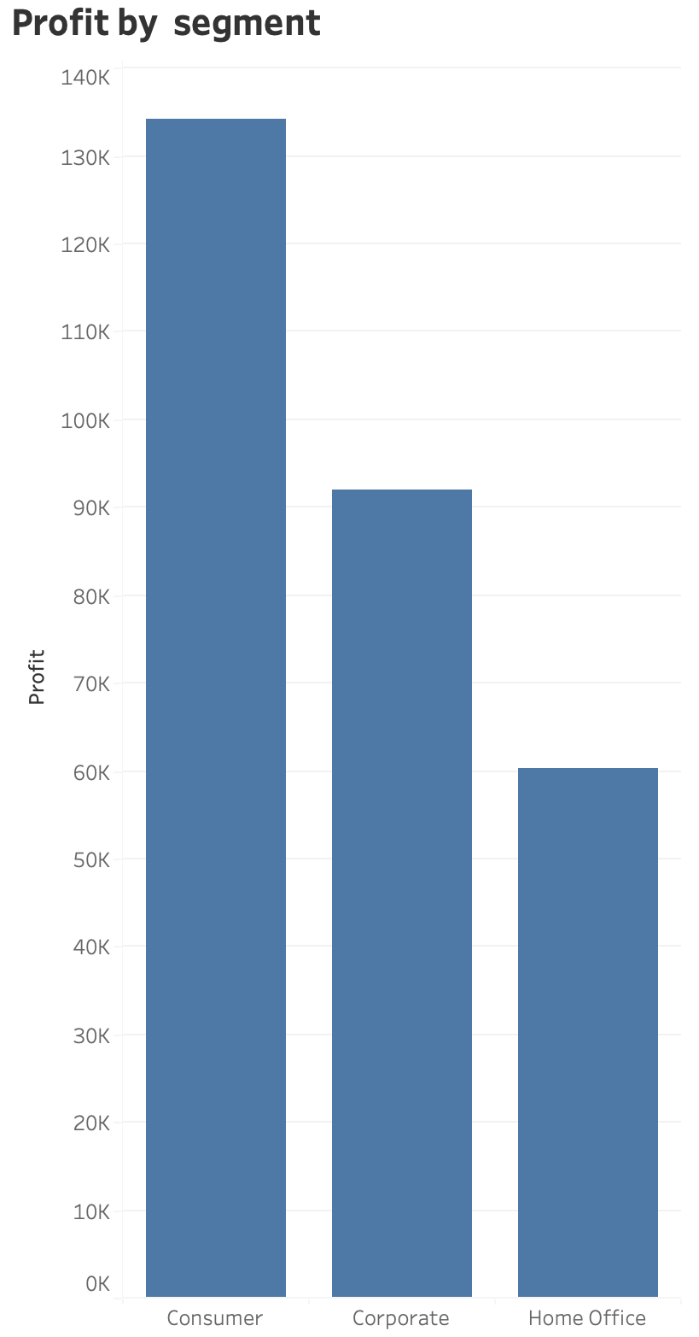
The three segments are more or less as profitable as their share of the sales.

Slide 6
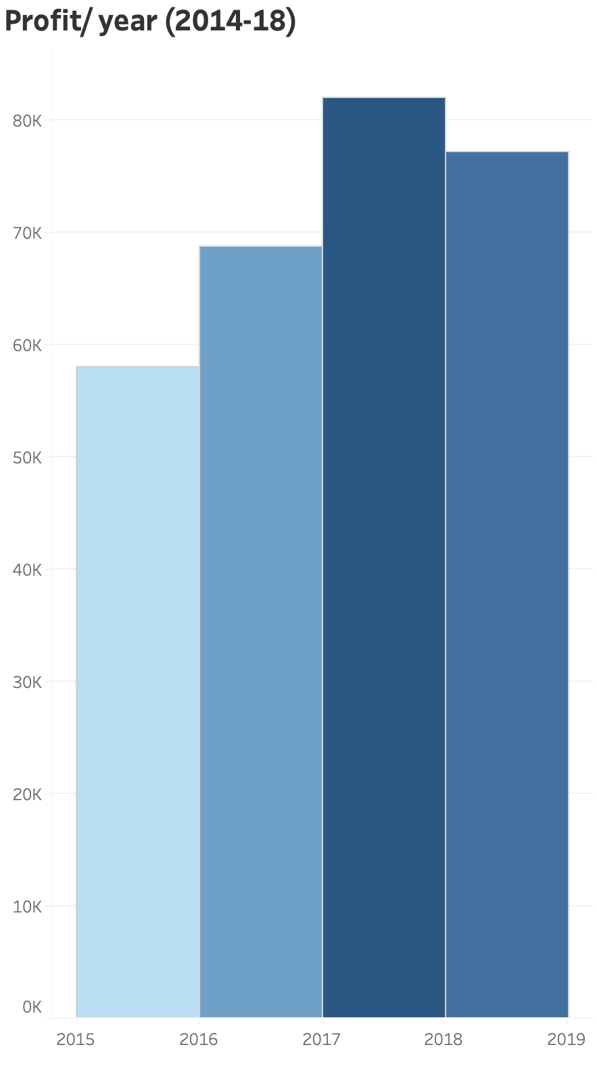

The trend of profit seems to show growth from year to year, with the exception of 2018. However...(next slide)

Slide 7
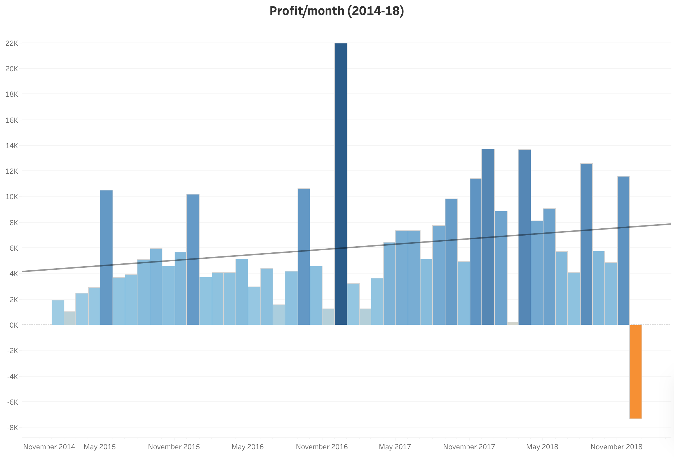

… the profit is growing, but not linearly.
Dividing the profit per month, shows that there is a cycle that is independent on years, but perhaps closer to a two-year’s cycle.
)The December 2016’s sales column (highest, middle) seems to be unnaturally high and might be a mistake.(

Slide 8
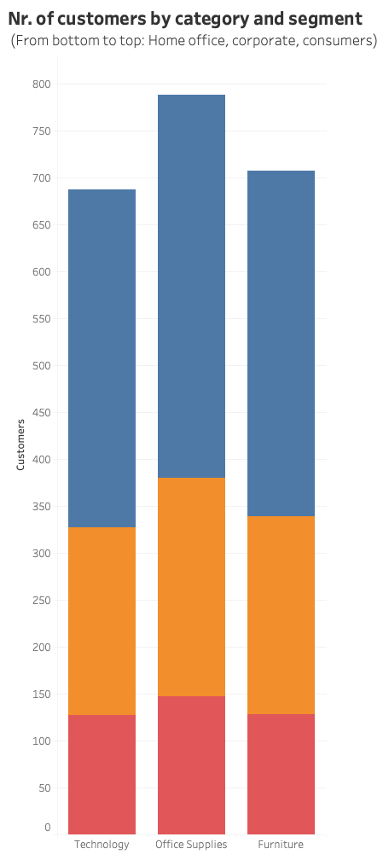

Every segment of customers purchases ca. the same portion of products from each category as the others.

Slide 9
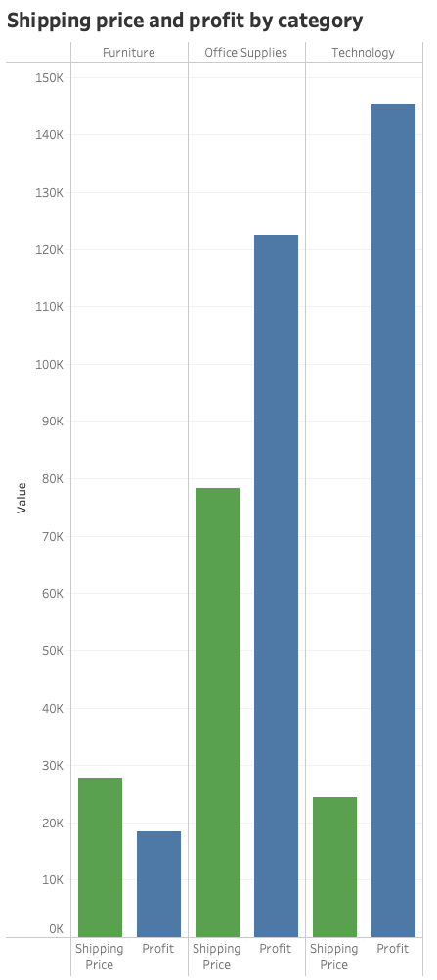

The most profitable product category is technology, followed by office supply, with a small gap between them.
Furniture is far less profitable product category (*).
(*) Is it because of the higher cost of shipment, because of the weight and volume of the products, or other factors?).

Slide 10
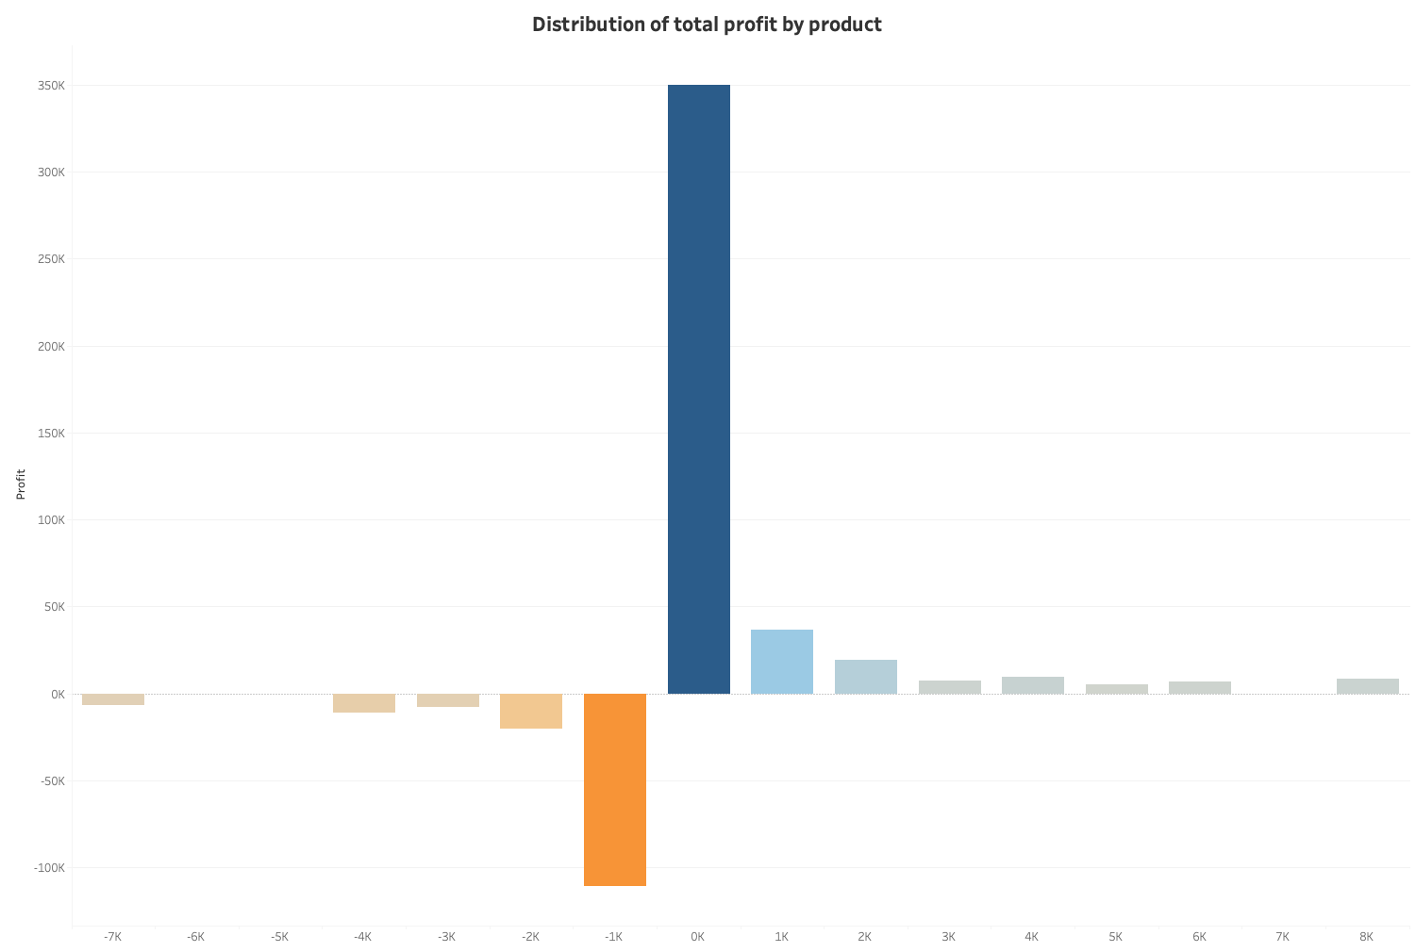

The vast majority of products are very little profitable. Few are highly profitable. There are far too many products that cost Unicorn a lot of money. (I would advise studying what products should not be offered).

Slide 11
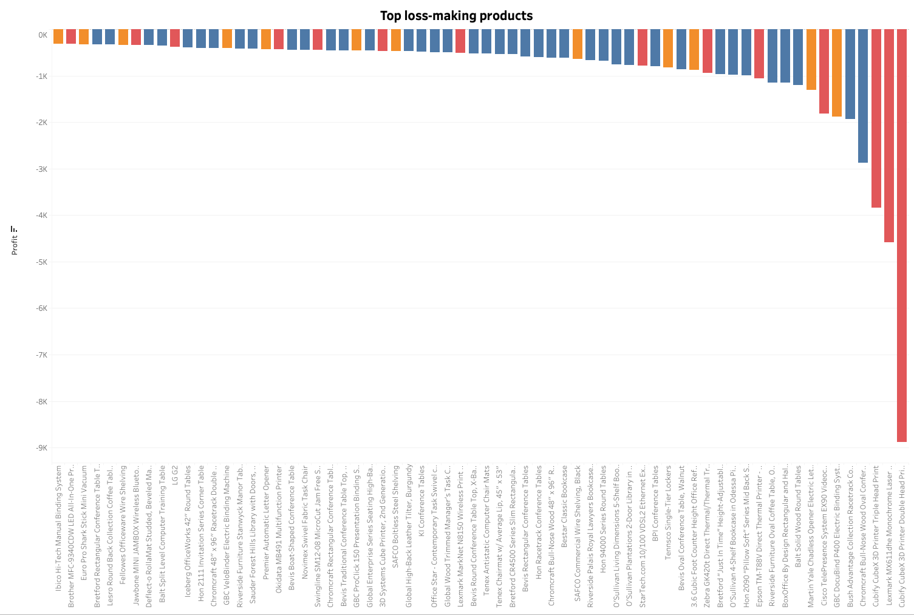

Few products, that are not profitable, should not be sold.
It concerns all categories.
However, the profitability of a product varies from year to year.
Unicorn should analyze why it looses money on them.

Slide 12
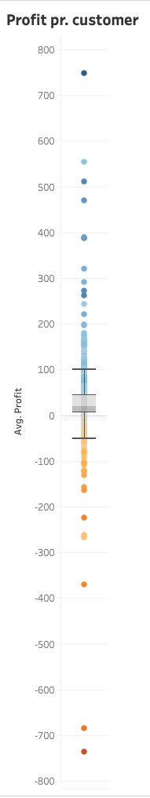

Looking at the average profitability, the median profit/customer is 20$.
Although most of the customers are profitable, far too many are not, and some cost Unicorn a lot of money.
Unicorn should terminate working with them, or alternatively demand a higher price to cover the expenses.

Slide 13
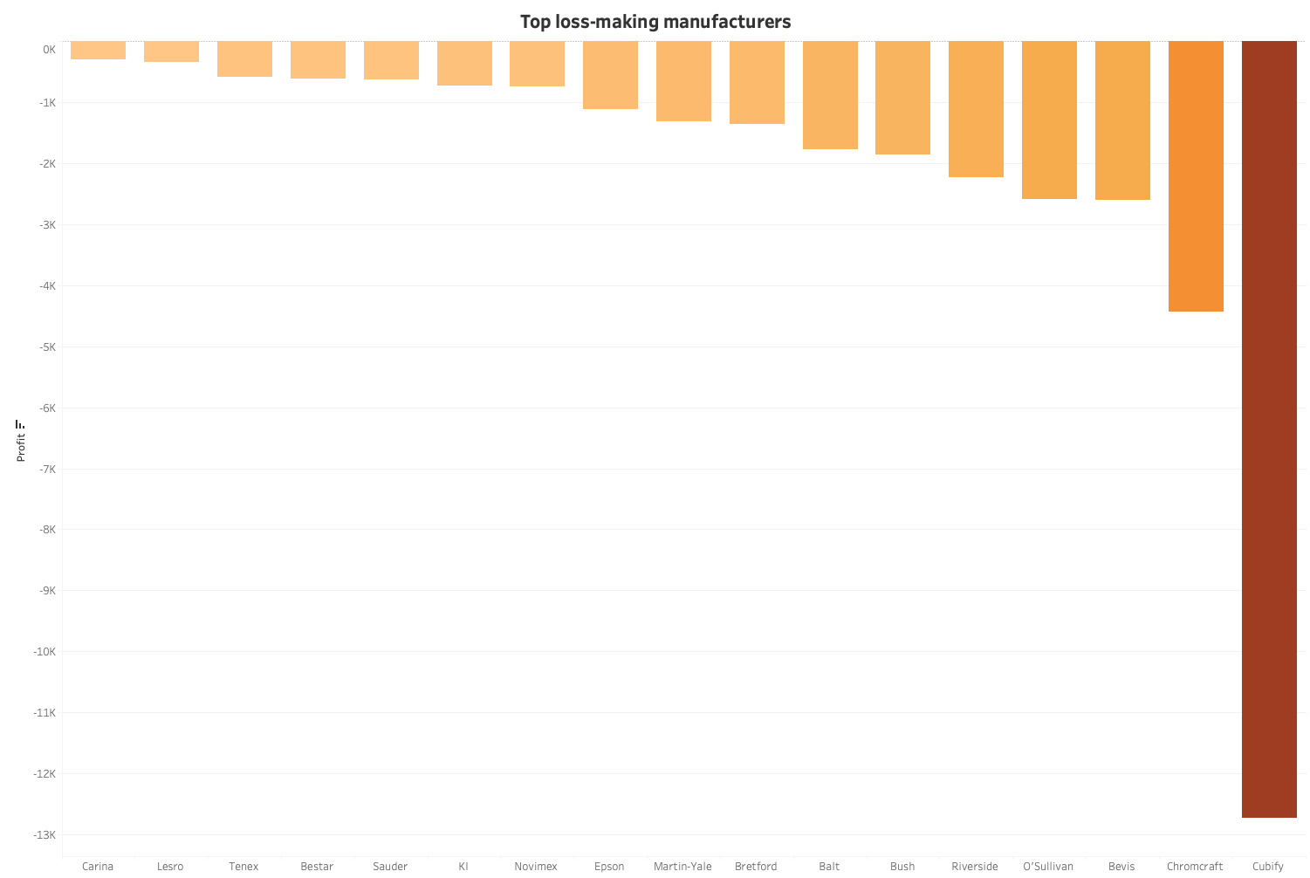

Unicorn makes a small profit from most of the manufacturers of it’s products. Some of them brings Unicorn nice profit, and a few of them were uneconomical.
I suggest not selling products by Cubify, Bevis, Bretford.
However, most of the loss-making manufacturers performed differently from year to year.
Suggestion: Not much to save here.

Slide 14
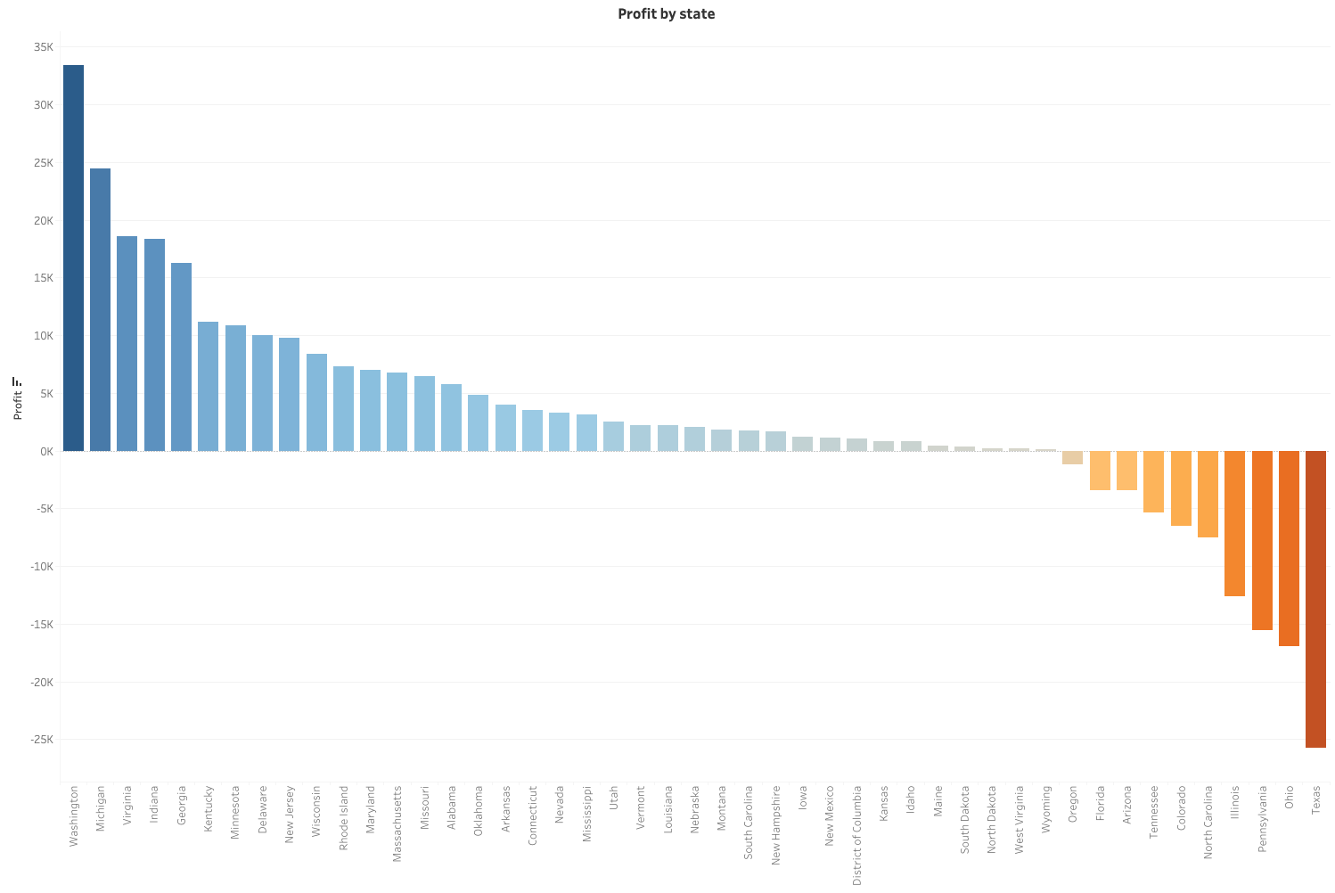
While selling to most of the states is profitable, selling to some of them cost Unicorn money.
E.g. Texas, Pennsylvania, Ohio.
Suggestion: we should learn why, and either correct the mistakes or consider selling in these states for higher delivery prices.

Slide 15
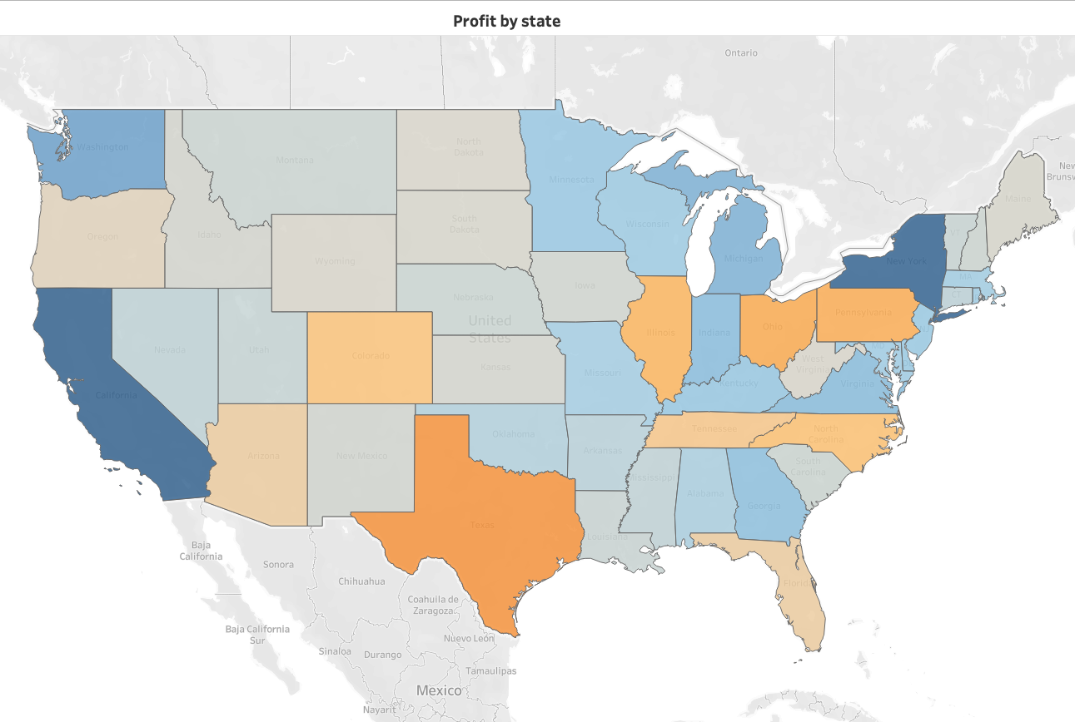

The geographical distribution of profitability doesn’t show any pattern I recognize.

